Slide 1

Progress Seminar for 8th Semester Industry Internship
Presented By: Kunal Choure
Organization: Cognizant
Location: Chennai
Role: Program Analyst Trainee
Date: 9th May 2026

Slide 2

Cognizant
Cognizant is a leading multinational IT services and consulting organization specializing in digital transformation and enterprise technology solutions.
Cognizant's Core Values
Work as One – Collaborate and succeed together
Raise the Bar – Continuously strive for excellence
Dare to Innovate – Encourage innovation and new ideas
Do the Right Thing – Act with integrity and ethics
Own It – Take accountability and responsibility
Founded in 1994
Headquartered in the United States
Global presence across 40+ countries
Expertise in digital transformation and enterprise solutions

Slide 3

INTERNSHIP Domain
My Domain – Adobe Experience Manager (AEM)
Adobe Experience Manager (AEM) is an enterprise-level Content Management System used to manage digital content and large-scale websites for global organizations.
Key Focus Areas
Frontend development foundations
Backend fundamentals
Enterprise CMS understanding
Preparation for AEM implementation

Slide 4

Internship Overview
Date of Joining
Final Assessment
31st Jan 2026
26th May 2026
The internship is structured into two progressive stages with formal performance evaluations at each milestone to ensure comprehensive skill development and readiness for enterprise-level responsibilities.

Slide 5
Internship Progress Summary
​
Internship joined on 31st Jan 2026 ​
​
Training structured into two stages ​
​
Stage 1 completed successfully ​
​
Stage 2 currently in progress

Slide 6
Learning Platform & Execution Model
Training is delivered through a dedicated TeckStac learning platform that ensures practical
implementation alongside theoretical learning.
Platform Features
Weekly hands-on assignments aligned with current topics
Defined submission deadlines for accountability
Topic-aligned practical exercises
Continuous performance tracking and feedback

Slide 7
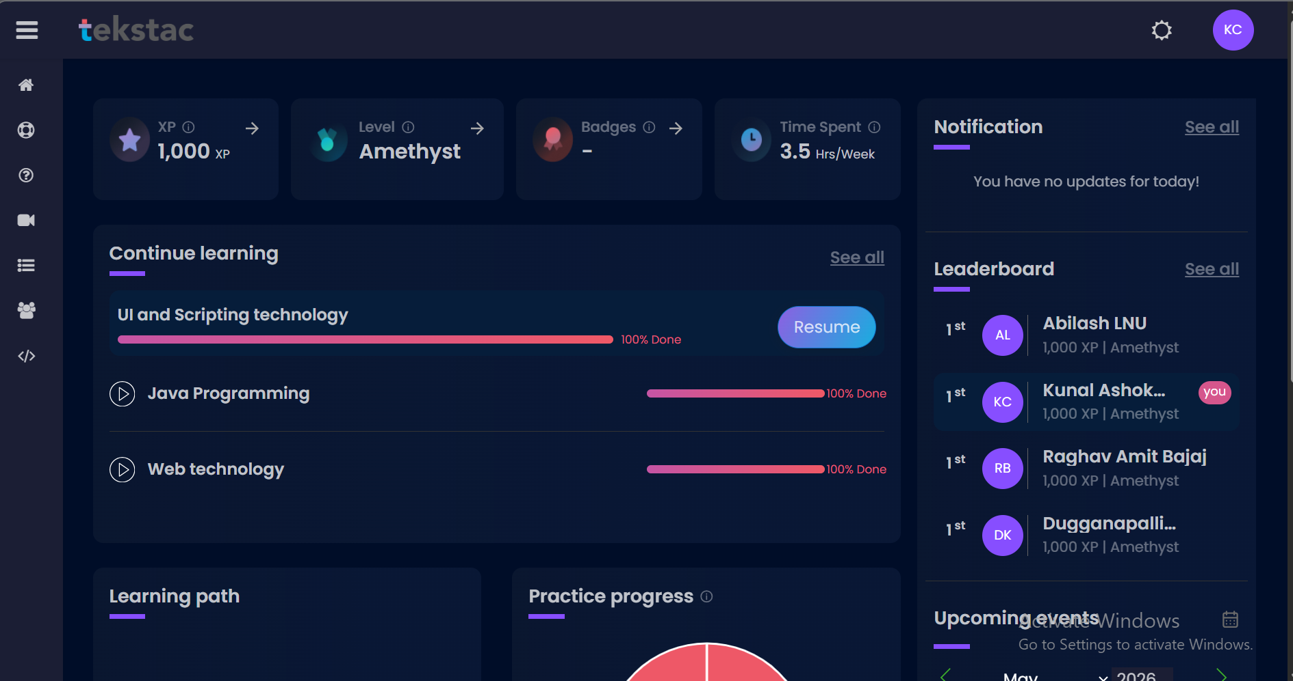

Teckstac Interface

Slide 8
Assessment Structure
Stage 1 Assessment
1
19th March
2
Interim Assessment
21th April
Final Assessment
3
22-26th May
Success Requirement: Achieve Green status in final assessments to successfully complete the internship program and demonstrate readiness for enterprise development roles.

Slide 9
SAGE 1
Foundation Training
Technologies Covered
Duration
HTML – Structure and semantic markup
CSS – Styling and responsive design
JavaScript – Client-side interactivity
Core Java – Object-oriented programming fundamentals
JSP – Java Server Pages for dynamic content
JDBC – Database connectivity and operations
. Servlet – Server side request handling
9th Feb to 19th March
Assessment
19th March
Foundation training successfully completed

Slide 10
SAGE 1
Stage 1 Assessment Outcome
Assessment Type: MCQ-based test covering all Stage 1 topics
Result: 93% | Stage 1 Successfully Cleared

Slide 11

STAGE 2
AEM Specialization
Focus Area: Adobe Experience Manager (AEM)
Timeline
Stage 2 transitions from foundational web technologies to enterprise-level content management system expertise, preparing for real-world digital experience implementations.
Duration: Post 19th March to 26th May
Learning Objectives
Enterprise CMS architecture understanding
Component-based development methodology
Advanced implementation exposure
Content authoring and workflow management

Slide 12
STAGE 2
Interim Evaluation Outcome
Assessment Type: AEM specialization assessment covering Stage 2 topics
Result: Green Status | Interim Evaluation Successfully Cleared

Slide 13
Stage 2 – Current Progress
Currently in Week 14 of the training program, demonstrating consistent progress and active engagement with the curriculum.
Completed
Ongoing
AEM Fundamentals & Maven Project Structure
Components, HTL, Templates, ClientLibs & Dialogs
OSGi Configurations & Sling Servlets
Touch UI, RTE & User Groups
AEM Assets & Tagging Framework
Stage 2 AEM specialization training
Hands-on practice and learning in progress

Slide 14
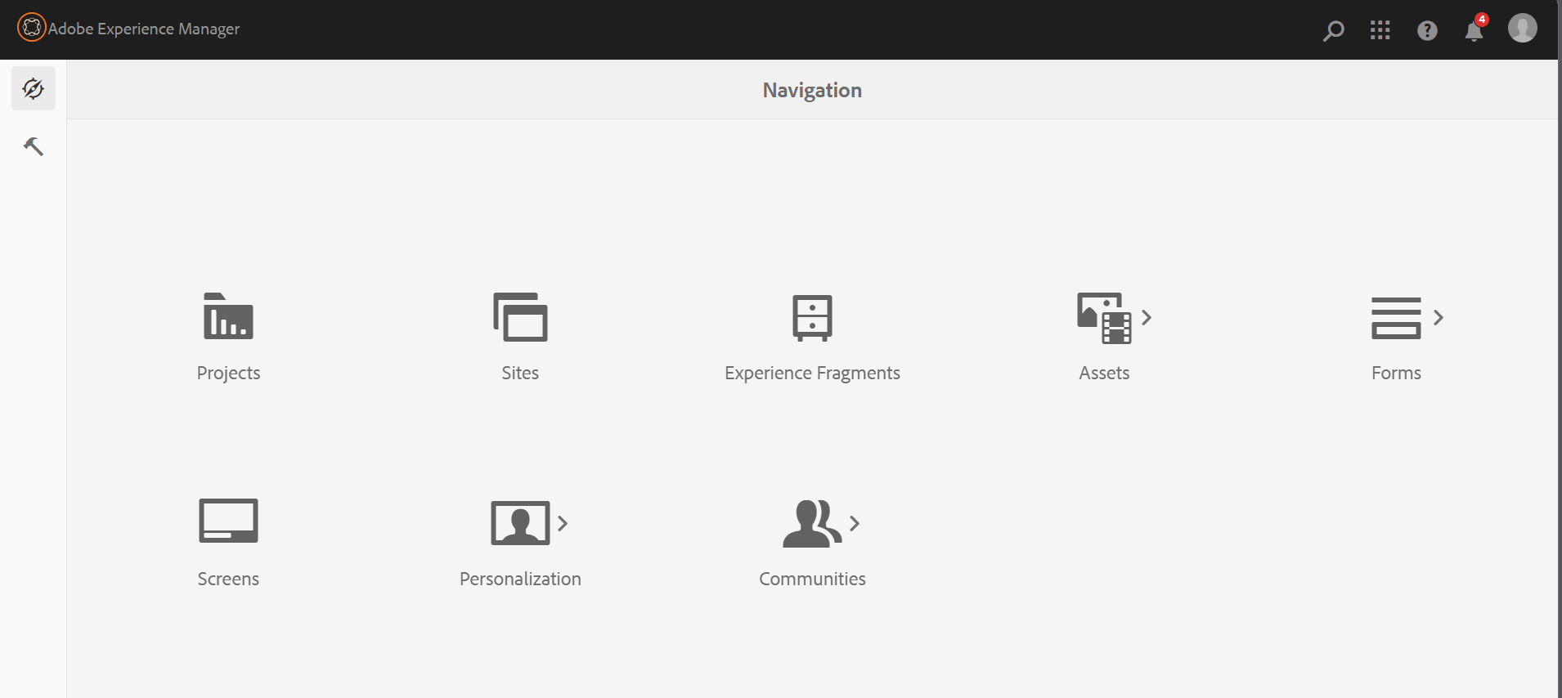
Key Features and AEM Interfaces
AEM Dashboard

Slide 15
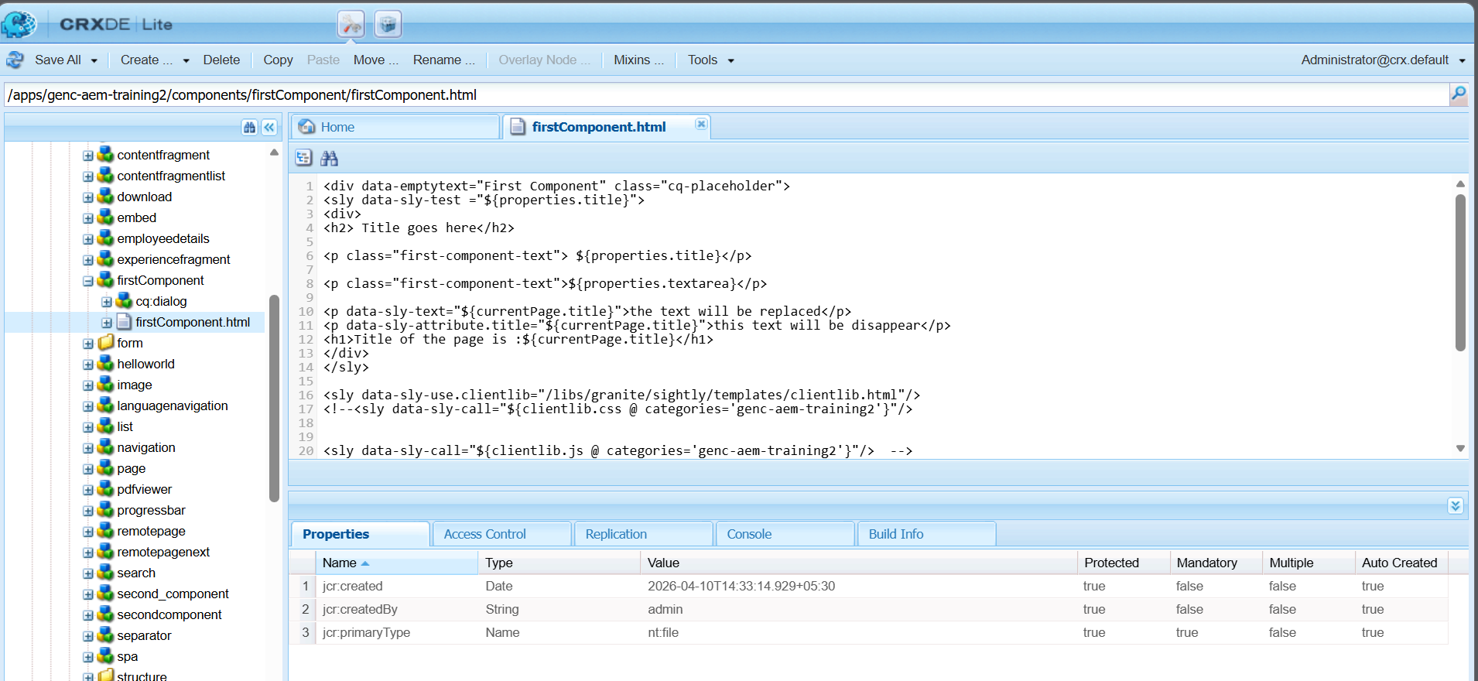
CRX-DE Java Content Repository

Slide 16
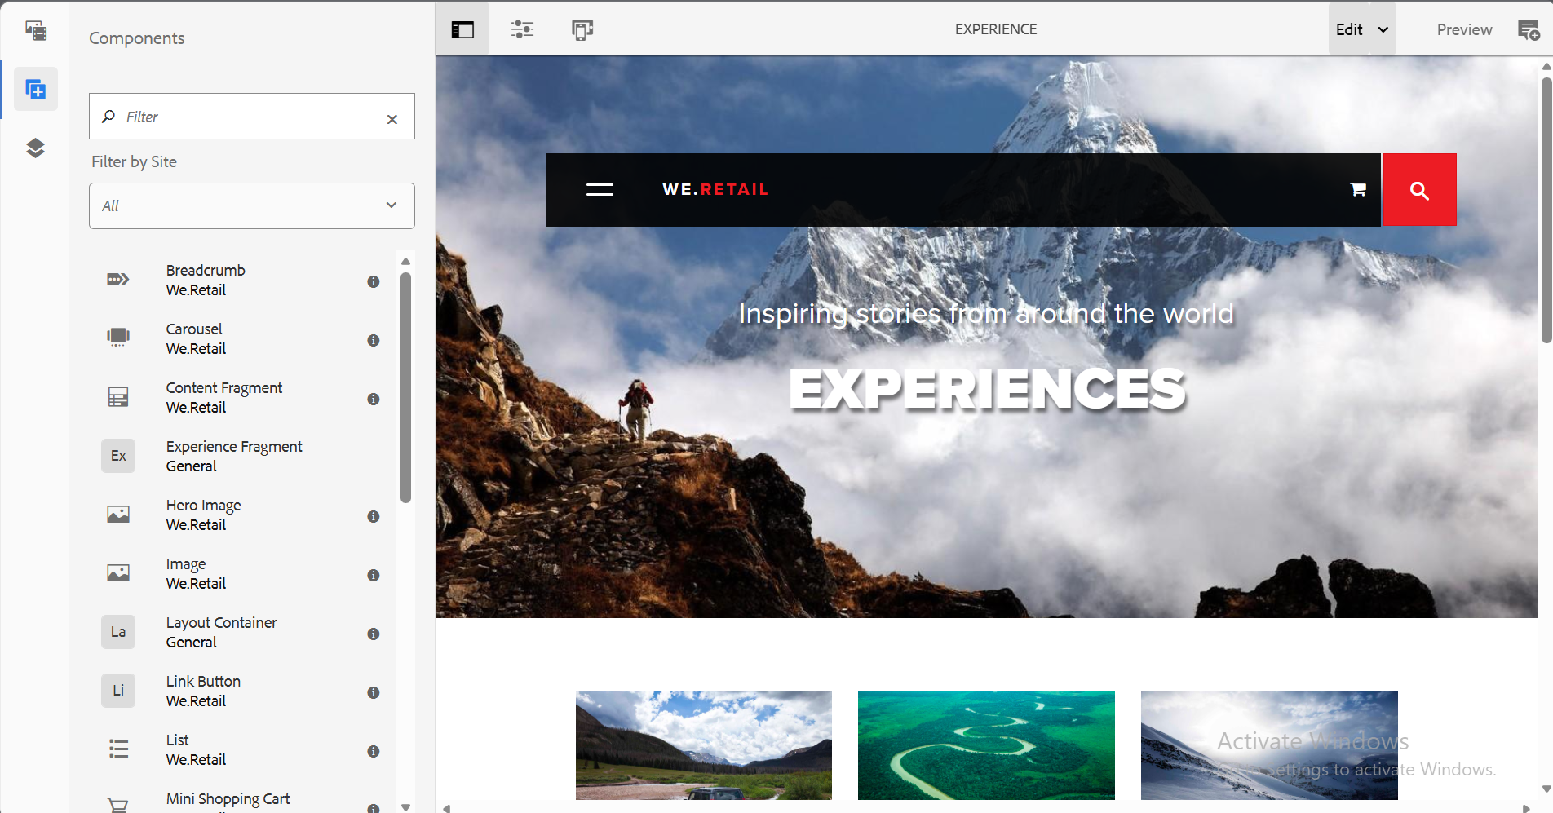
Page Creation Interface

Slide 17
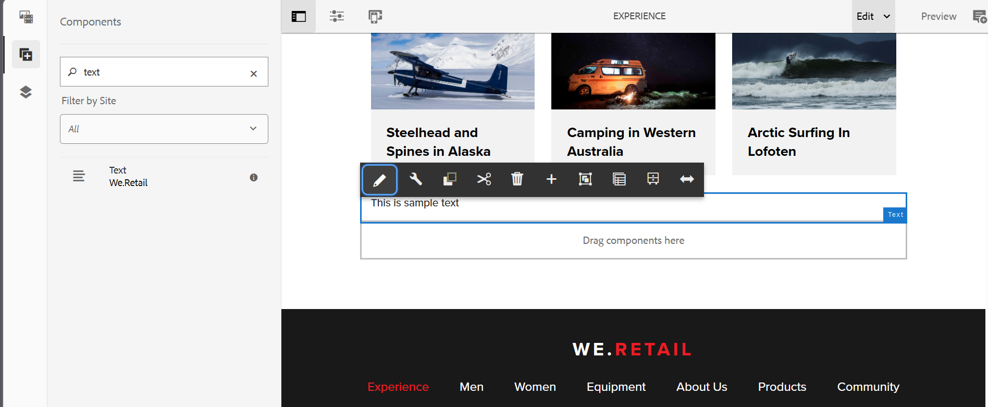
RTE –Rich Text Experience

Slide 18
THANK YOU

